Slide 1


Resume Screening App
This is a simple web application that screens and categorizes resumes using Natural Language Processing (NLP) techniques. It allows users to upload resume files in either .txt or .pdf format, and it predicts the category or job role associated with the uploaded resume.

Slide 2
Logistic Regression
Logistic Regression is a statistical method used for binary classification tasks, where the goal is to predict the probability that an instance belongs to one of two classes.
Logistic Regression was not the best fit for our project because it:
Assumes linear relationships and doesn't capture complex interactions well.
Struggles with imbalanced datasets.
Doesn't perform as well on high-dimensional text data.
Random Forest is better suited for these types of tasks because:
It handles non-linear relationships and complex interactions.
It's more robust with imbalanced datasets.
It can better manage the complexity of high-dimensional data like text.
Designed by Group-4

Slide 3
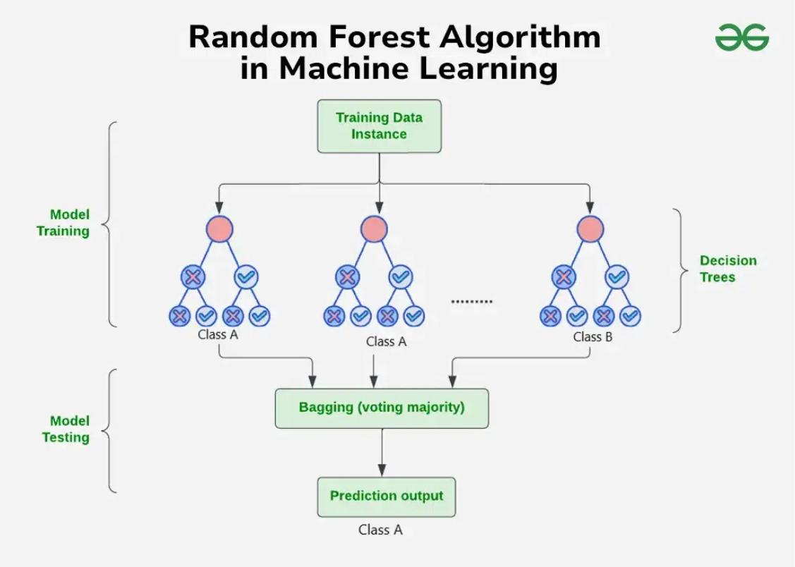
Random Forest Algorithm in Machine Learning
A Random Forest is a collection of decision trees that work together to make predictions. This powerful tree learning technique in Machine Learning is widely used for classification and regression tasks.
Random Forest takes different random parts of the dataset to train each tree and then combines the results by averaging them. This approach helps improve the accuracy of predictions and is based on ensemble learning.

Slide 4
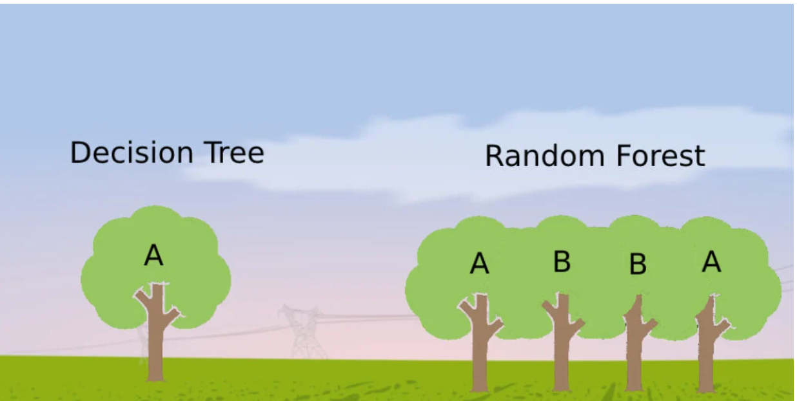


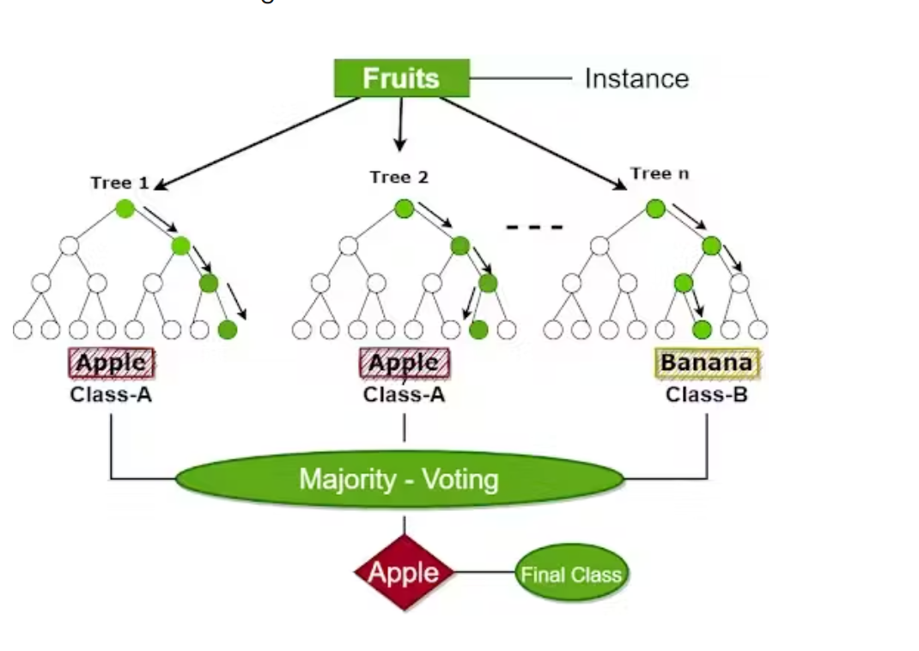


How Random Forest Works
Build Multiple Trees
Random Forest builds multiple decision trees using random samples of the data, making each tree unique.
Random Feature Selection
When creating each tree, the algorithm randomly selects a subset of features rather than using all available features.
Individual Predictions
Each decision tree makes a prediction based on the data it was trained on.
Combine Results
For classification, the final prediction is decided by majority vote. For regression, it's the average of all tree predictions.

Slide 5

Key Features of Random Forest
Handles Missing Data
Feature Importance
Automatically handles missing values during training, eliminating the need for manual imputation.
Algorithm ranks features based on their importance in making predictions, offering valuable insights for feature selection and interpretability.
Scales Well
Versatile Application
Performs effectively with large and complex data without significant performance degradation.
Can be applied to both classification tasks (predicting categories) and regression tasks (predicting continuous values).

Slide 6








Random Forest Intuition
Diverse Opinions
Group Decision
Each decision tree is trained on different subsets of data, providing diverse "opinions."
Like asking a group of friends for advice, each with their unique perspective.
Better Results
Collective Wisdom
This ensemble approach typically produces more accurate and reliable predictions than any single tree.
The final decision considers the majority opinion or averages all suggestions.

Slide 7
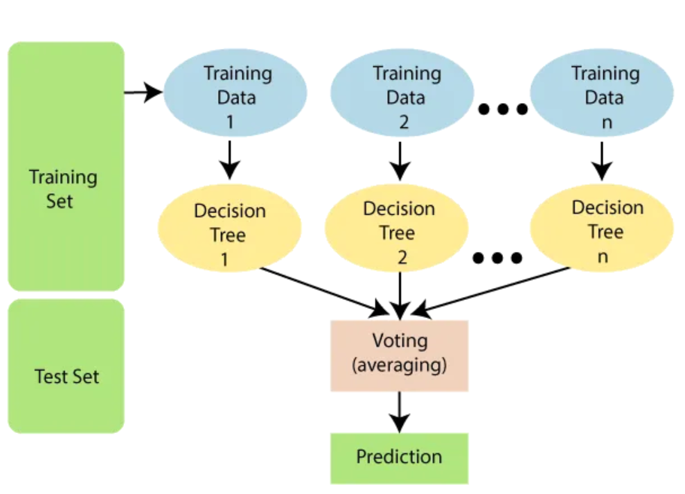




Assumptions of Random Forest
Independent Trees
Every tree in the forest makes its own predictions without relying on others.
Random Sampling
Each tree is built using random samples and features to reduce mistakes and prevent overfitting.
Sufficient Data
Enough data ensures the trees are different and learn unique patterns and variety.
Diversity Improves Accuracy
Combining the predictions from different trees leads to more accurate final results.

Slide 8

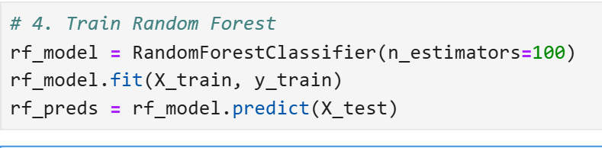
Classification with Random Forest
Data Preparation
Process the dataset by handling missing values and encoding categorical features like ‘Data science' in the dataset.
Model Training
Initialize a RandomForestClassifier with parameters like n_estimators=100 and fit it to the training data.
Prediction & Evaluation
Make predictions on test data and evaluate performance using metrics like accuracy (0.88) and classification report.

Slide 9
Advantages and Limitations
Advantages
Limitations
Provides very accurate predictions even with large datasets
Can be computationally expensive, especially with many trees
Handles missing data well without compromising accuracy
Harder to interpret compared to simpler models like decision trees
Doesn't require normalization or standardization
May require more memory for large datasets
Reduces the risk of overfitting by combining multiple trees
Can be slower for real-time predictions with many trees

Slide 10
Real-World Applications of Random Forest
Healthcare
Human Resources
Disease diagnosis (e.g., cancer, diabetes)
Resume screening & employee attrition prediction
Finance
Agriculture & Environment
Fraud detection in transactions
Crop disease prediction
Marketing & E-commerce
Product recommendation & sentiment analysis

Slide 11
References
CareerFoundry. (2023, March 9). What is random forest?
A beginner's guide. https://careerfoundry.com/en/blog/data-analytics/what-is-random-forest/
Divakar. (2019, June 20). Random forest algorithm.
Medium. https://medium.com/@divakar1591/random-forest-algorithm-772d3e5568
Random Forest algorithm in machine learning.
GeeksforGeeks. https://www.geeksforgeeks.org/random-forest-algorithm-in-machine-learning/
Sharma, A. (2023, July 25). A comprehensive guide to ensemble learning.
GeeksforGeeks. https://www.geeksforgeeks.org/a-comprehensive-guide-to-ensemble-learning/
Wikipedia contributors. (2024, April 20). Random forest.
Wikipedia. https://en.wikipedia.org/wiki/Random_forest

